Slide 1
Lesson 2:
Fundamentals of Twitter Bootstrap

Slide 2
Introduction
What is Bootstrap?
  It is a open source front-end CSS framework for faster and easier web development
  Includes HTML and CSS based design templates for
Typography Forms Buttons Tables | Navigation Modals Image carousels As well as optional JavaScript plugins

Slide 3
introduction
  Gives us the ability to easily create responsive designs
Responsive Design?
  Creating web sites which automatically adjust themselves to look good on all devices, from small phones to large desktops.
It was developed by Mark Otto and Jacob Thornton at Twitter
And released as open source product in August 2011 on GitHub

Slide 4
introduction
Why Bootstrap?
  Easy to use: Anybody with just basic knowledge of HTML and CSS can start using it
  Responsive features: adjusts to phones, tablets, and desktops
  Mobile-first approach: In Bootstrap 3, mobile-first styles are part of the core framework
  Browser compatibility: Bootstrap is compatible with all modern browsers
    Eg. Chrome, Firefox, Internet Explorer, Edge, Safari, and Opera

Slide 5
Getting started
Getting Bootstrap
Two ways
  Download from https://getbootstrap.com/docs/3.3/ OR
  Include Bootstrap from a CDN

Slide 6
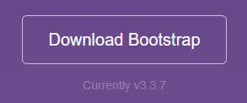
Getting started
Download from https://getbootstrap.com/docs/3.3/
  Download all files and dependencies of bootstrap as compressed zip file.
  Then add it to your project as an external CSS file

Slide 7
Getting started
Include Bootstrap from a CDN
  If you want it from online repository as external CSS, you can include it from external CDN (Content Delivery Network)
  You can find a number of CDN providers but for this lesson we are going to use the following.

Slide 8
Getting started
<!-- Latest compiled and minified CSS -->
<link rel="stylesheet"href="https://maxcdn.bootstrapcdn.com/bootstrap/3.3.7/css/bootstrap.min.css">

Slide 9
Getting started
<!-- jQuery library -->
<script src="https://ajax.googleapis.com/ajax/libs/jquery/3.3.1/jquery.min.js"></script>

Slide 10
Getting started
<!-- Latest compiled JavaScript -->
<script src="https://maxcdn.bootstrapcdn.com/bootstrap/3.3.7/js/bootstrap.min.js"></script>

Slide 11
Getting started
Advantage of using CDN
  Faster loading time.
    Many users already have downloaded Bootstrap from MaxCDN when visiting another site. As a result, it will be loaded from cache when they visit your site, which leads to faster loading time.
    Also, most CDN's will make sure that once a user requests a file from it, it will be served from the server closest to them, which also leads to faster loading time.

Slide 12
Getting started
jQuery
  Bootstrap uses jQuery for JavaScript plugins (like modals, tooltips, etc).
  But, if you use only the CSS part of BS, you don’t need jQuery

Slide 13
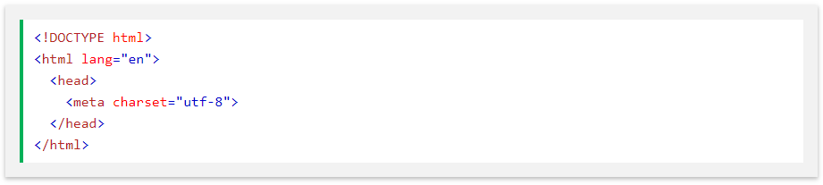
Create 1st web page
Add the HTML5 doctype
  BS uses HTML elements and CSS properties that require the HTML5 doctype.

Slide 14
Create 1st web page
add the following <meta> tag inside the <head> element:
Mobile-first approach:
  To enable m-first for your design, add the following <meta> tag inside the <head> element.
  The width=device-width part sets the width of the page to follow the screen-width of the device (which will vary depending on the device).

Slide 15
Create 1st web page
The initial-scale=1 → sets the initial zoom level when the page is first loaded by the browser.
Containers
  BS needs a containing element to wrap site contents.
  Two container classes to choose from:

Slide 16


Create 1st web page
.container
.container-fluid

Slide 17
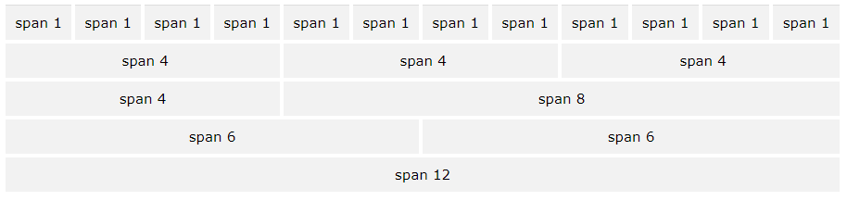
Bootstrap grid system
Bootstrap's grid system allows up to 12 columns across the page.
If you do not want to use all 12 columns individually, you can group the columns together to create wider columns:

Slide 18
Create 1st web page
Grid classes : 4 classes
    xs (for phones - screens less than 768px wide)
    sm (for tablets - screens equal to or greater than 768px wide)
    md (for small laptops - screens equal to or greater than 992px wide)
    lg (for laptops and desktops - screens equal to or greater than 1200px wide)
  The classes above can be combined to create more dynamic and flexible layouts.

Slide 19
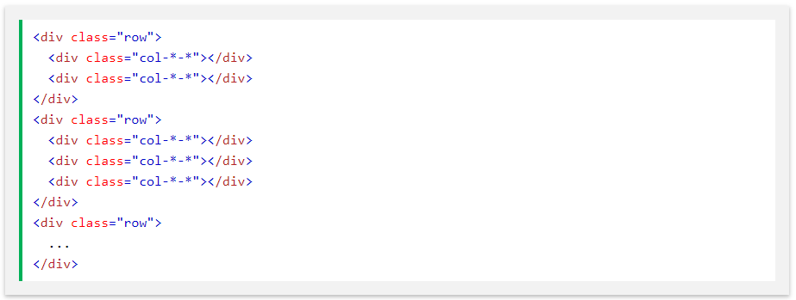
Bootstrap grid system
Basic structure of grid:

Slide 20
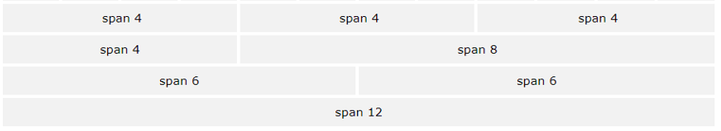
Bootstrap grid system
Exercise:
  Create a webpage with the following grid system

Slide 21
Text / typography
Text / Typography
  Bootstrap’s default settings:
    Global default font-size is 14px. With a line-height of 1.428
    This is applied to the <body> element and all paragraphs

Slide 22
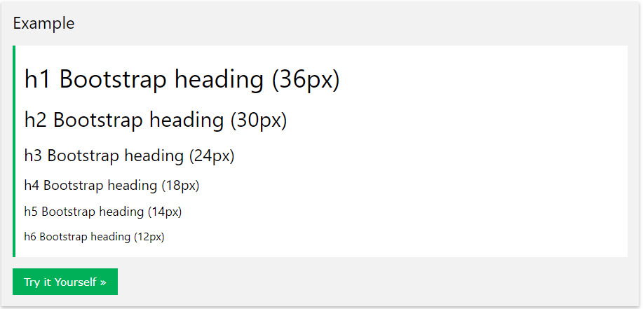
Text / typography
By default, Bootstrap will style the HTML headings (<h1> to <h6>) in the following way:

Slide 23
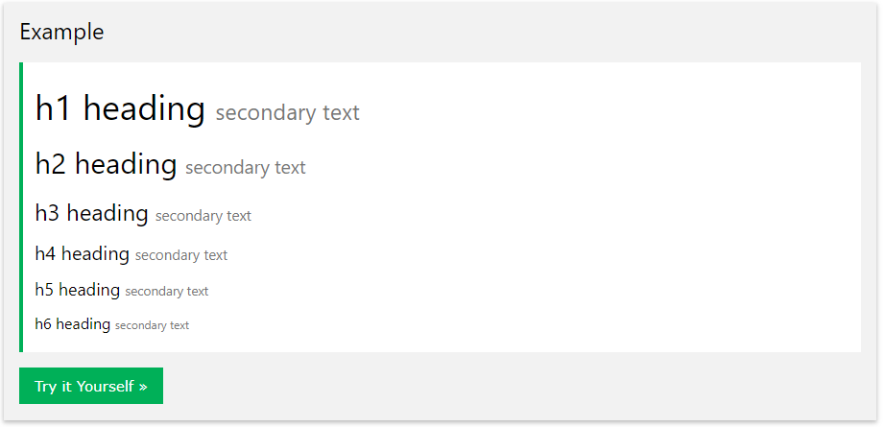
Text / typography
<small>
In Bootstrap the HTML <small> element is
used to create a lighter, secondary text in any heading:

Slide 24
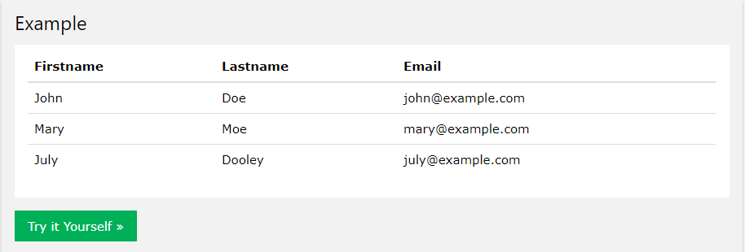
tables
Tables
Basic table
  The .table class adds basic styling to a table:

Slide 25
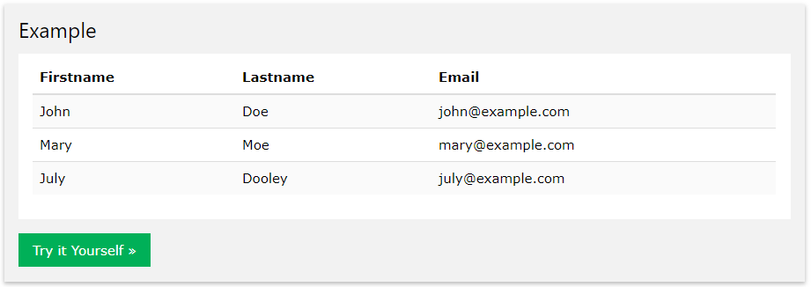
tables
Striped rows
  The .table-striped class adds zebra-stripes to a table:

Slide 26
tables
More table classes / properties
  Hover rows: The .table-hover class adds a hover effect (grey background color) on table rows:
  Condensed Table: The .table-condensed class makes a table more compact by cutting cell padding in half
  Contextual classes: used to color table rows
  Responsive tables: automatically creates horizontal scroll bar for small device displays.
    Use .table-responsive class
  The .table-hover class adds a hover effect (grey background color) on table rows:

Slide 27
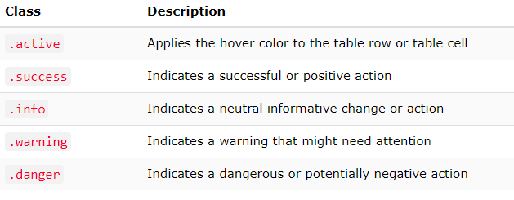
images
Contextual classes

Slide 28



Images
<img src="cinqueterre.jpg" class="img-circle" alt="Cinque Terre">
.img-rounded
.img-circle
.img-thumbnail

Slide 29
images
Responsive images
  automatically adjust to fit the size of the screen.
  Use .img-responsive to make the image responsive

Slide 30
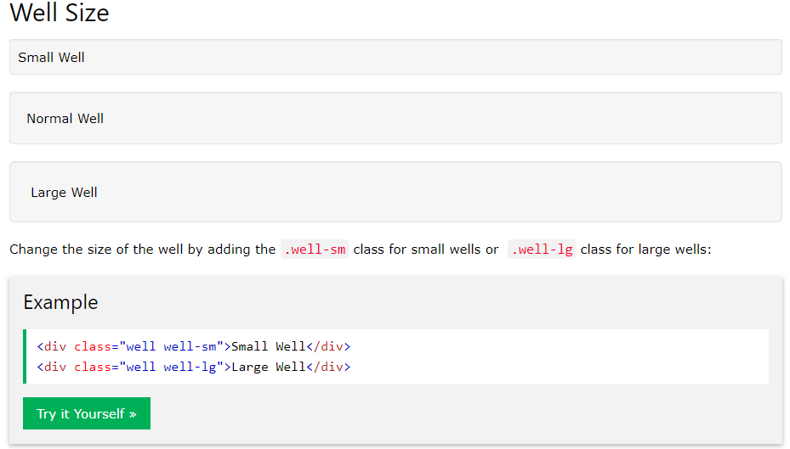
Well

Slide 31
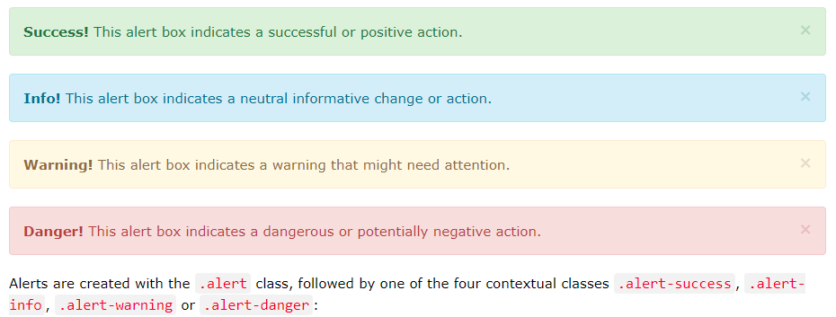
alerts
Bootstrap provides an easy way to create predefined alert messages:

Slide 32
Thank You!

